Slide 1
Customer Segmentation Insights
Using K-Means Clustering
Abdallah Sana - 08/26/2025

Slide 2
Business Objective
Understand different types of customers
Optimizing marketing strategy
Improving retention and revenue

Slide 3
Approach
Data used (demographics, spending behavior, engagement)
KMeans algorithm used to group customers into X segments
Data
Clustering
Segments

Slide 4
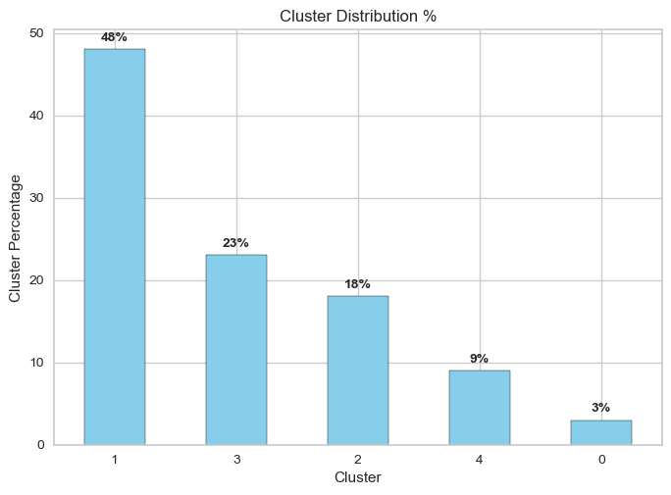
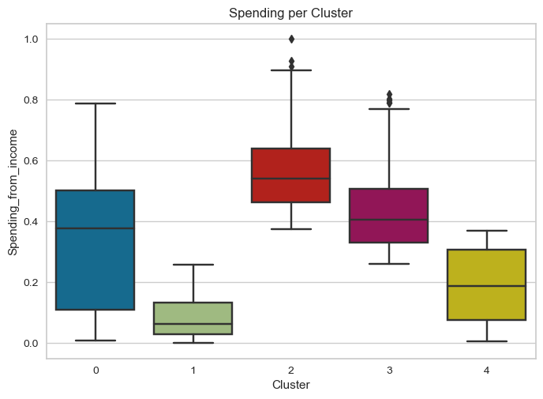
Results
Cluster 0 | Cluster1 | Cluster2 | Cluster3 | Cluster4
Mostly young non-parents with moderate spending (~35% of income). | Exclusively adult parents with very low spending (~9% of income). | Adult non-parents with high spending (~56% of income). | Adult parents with moderate-to-high spending (~43% of income). | Adult non-parents with low spending (~19% of income).

Slide 5
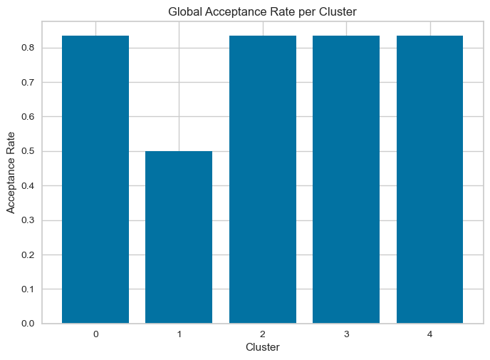
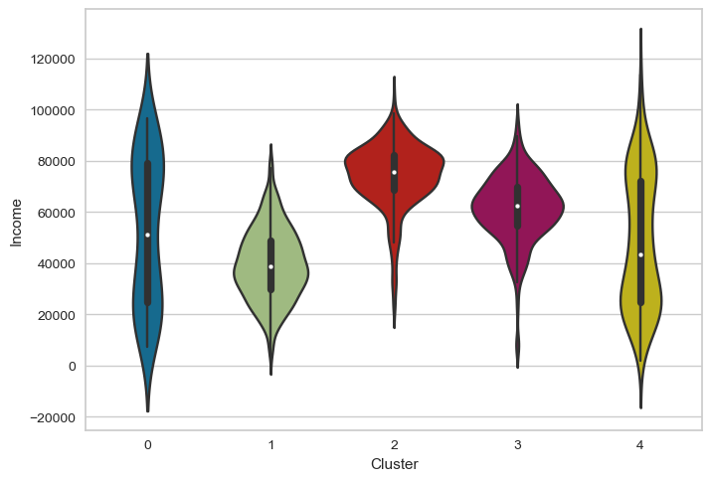
Cluster 0 has the widest spread, including some very low and very high incomes.
Cluster 1 is centered around lower incomes (~30K–50K).
Clusters 2 and 3 concentrate around higher mid-level incomes (~60K–80K).
Cluster 4 is diverse, spanning from low to high incomes, but with a concentration near 70K.
👉 Key takeaway: Cluster 1 represents a low-income, low-acceptance group, while the other clusters generally show higher incomes and higher acceptance rates.

Slide 6
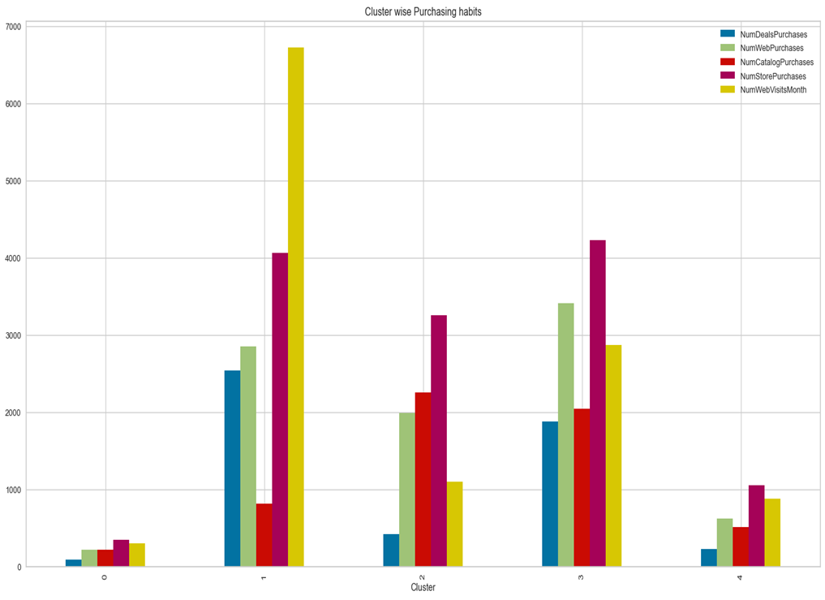


Slide 7
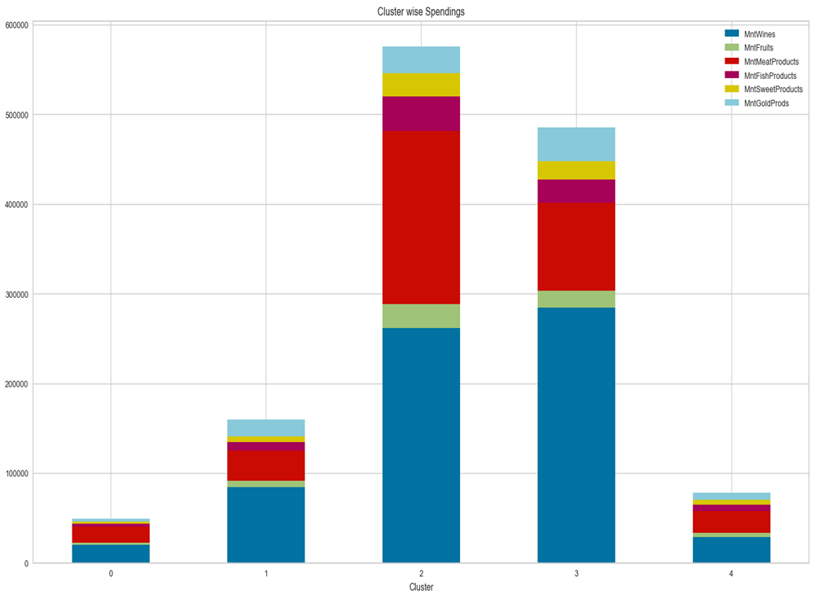

Slide 8
Recommendations
Cluster 0 👉 Offer lower-cost but stylish, attractive products (like entry-level or lifestyle-focused items) to appeal to diverse income levels. Highlight wines and meat, which align with their spending habits, using trendy bundles or promotions. Use digital channels (social media, influencers) to connect with the younger segment.
Cluster 1 👉 Provide value-oriented promotions, discounts, and family bundles featuring meat and wine, as this group is highly budget-conscious yet spends more in these categories. De-emphasize premium items like gold, fish, or fruits.
Cluster 2 👉 Target with premium wine and meat packages, subscriptions, and loyalty programs. Emphasize exclusivity, quality, and convenience, while avoiding less popular categories (gold, fish, fruits). Personalized recommendations will resonate strongly here.
Cluster 3 👉 Promote mid-to-premium family-oriented products such as meat packs and wine bundles for home dining. Campaigns around family wellness or celebrations will fit well, while minimizing focus on gold, fish, and fruits.
Cluster 4 👉 Encourage engagement through affordable luxury, add-on services, or loyalty points. Position wine and meat as accessible lifestyle luxuries at reasonable costs. Downplay categories with low spending (gold, fish, fruits) to keep offers relevant.

